Slide 1
JSON and XML

Slide 2
Metaformats for data
Describe structure of the data --- syntax
Can then add semantics or meaning
Two widely used mataformats are:
eXtensible Markup Language (XML)
JavaScript Object Notation (JSON)

Slide 3
eXtensible Markup Language
Hierarchal file structure
Text based
Built on unicode

Slide 4
XML
XML 1.0 – a recommendation from W3C, 2008
Root: SGML (standard generalized markup language)
After the root: a format for sharing data

Slide 5
SGML
Derived from IBM’s GML developed in 1960’s
Charles Goldfarb, Edward Mosher, and Raymond Lorie
For sharing of large-project documents
Basis for HTML & XML
XML is roughly an augmented subset (adds more restrictions)
HTML is an application of SGML

Slide 6
Why XML is of Interest to Us
XML is just syntax (serialization format) for data
Note: we have no syntax for relational data
But XML is not relational: semi-structured
This is exciting because:
Can translate any data to XML
Can ship XML over the Web (HTTP)
Can input XML into any application
Thus: data sharing and exchange on the Web

Slide 7
XML Data Sharing and Exchange
application
application
object-relational
Integrate
XML Data
WEB (HTTP)
Transform
Warehouse
application
relational data
legacy data
Specific data management tasks

Slide 8
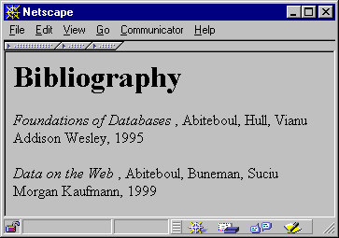
From HTML to XML
HTML describes the presentation

Slide 9
HTML
<h1> Bibliography </h1>
<p> <i> Foundations of Databases </i>
Abiteboul, Hull, Vianu
<br> Addison Wesley, 1995
<p> <i> Data on the Web </i>
Abiteoul, Buneman, Suciu
<br> Morgan Kaufmann, 1999

Slide 10
XML
<bibliography>
<book> <title> Foundations… </title>
<author> Abiteboul </author>
<author> Hull </author>
<author> Vianu </author>
<publisher> Addison Wesley </publisher>
<year> 1995 </year>
</book>
…
</bibliography>
XML describes the content

Slide 11
Markup and Content
Markup
Provides structure to data
begin with the character < and end with a >,
begin with the character & and end with a ;.
Content
Actual data within the file

Slide 12
XML Terminology
tags: book, title, author, …
start tag: <book>, end tag: </book>
elements: <book>…</book>,<author>…</author>
elements may be nested:
<book><author>…</author></book>
empty element: <red></red> abbrv. <red/>
an XML document: has a single root element
well formed XML document: if it has matching tags

Slide 13
Tag
A markup construct that begins with < and ends with >.
Three types of tags:
start-tags; for example: <section>
end-tags; for example: </section>
empty-element tags; for example: <line-break />

Slide 14
Element
A logical document component between a start-tag and ends and a matching end-tag or
an empty-element tag.
characters between the start- and end-tags, if any, are the element's content,
May be nested (child elements).
Example
<Greeting>Hello, world.</Greeting>.

Slide 15
Attribute
a name/value pair that exists within a start-tag or empty-element tag.
<img src="madonna.jpg" alt='Foligno Madonna, by Raphael' />
<step number="3">Connect A to B.</step>
Attributes can only have a single value and each attribute can appear at most, but you can code lists:
<div class="inner greeting-box" >Hello!</div>

Slide 16
XML declaration
XML documents may begin by declaring some information about themselves
<?xml version="1.0" encoding="UTF-8"?>

Slide 17
Element vs. Attribute (IBM)
Principle of core content
If you consider the information in question to be part of the essential material that is being expressed or communicated in the XML, put it in an element.
Principle of structured information
If the information is expressed in a structured form, especially if the structure may be extensible, use elements. I hope to expand on the treatment of people's names in markup in a future article.
Principle of readability
If the information is intended to be read and understood by a person, use elements.
Principle of element/attribute binding
Use an element if you need its value to be modified by another attribute.

Slide 18
Web Services
Wikipedia: a software system designed to support interoperable machine-to-machine interaction over a network
Use http for machine-machine communications of files
E.g., in XML & JSON formats
WSDL, SOAP (simple object access protocol)

Slide 19
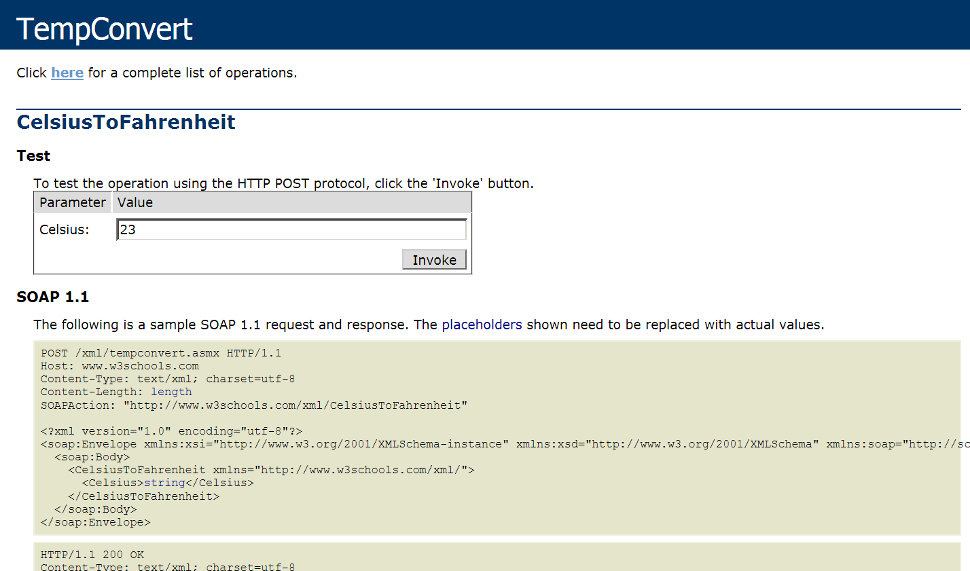
Web service example (link)

Slide 20
More XML: Attributes
<book price = “55” currency = “USD”>
<title> Foundations of Databases </title>
<author> Abiteboul </author>
…
<year> 1995 </year>
</book>
attributes are alternative ways to represent data

Slide 21
Attributes
<book price = “55” currency = “USD”>
Attribute values must be quoted, either double or single

Slide 22
More XML: Oids and References
<person id=“o555”> <name> Jane </name> </person>
<person id=“o456”> <name> Mary </name>
<children idref=“o123 o555”/>
</person>
<person id=“o123” mother=“o456”><name>John</name>
</person>
Must define them in schema

Slide 23
XML Semantics: an ordered tree
Element node
Attribute node
data
<data>
<person id=“o555” >
<name> Mary </name>
<address>
<street> Maple </street>
<no> 345 </no>
<city> Seattle </city>
</address>
</person>
<person>
<name> John </name>
<address> Thailand </address>
<phone> 23456 </phone>
</person>
</data>
person
person
id
name
address
name
address
phone
o555
Mary
street
no
city
Thai
John
23456
Maple
345
Seattle
Text node
Order matters !!!

Slide 24
XML Data
XML is self-describing
Schema elements become part of the data
Reational schema: persons(name,phone)
In XML <persons>, <name>, <phone> are part of the data, and are repeated many times
Consequence: XML is much more flexible
XML = semistructured data

Slide 25
Relational Data as XML
person
XML:
person
row
row
row
name
phone
name
phone
name
phone
“John”
3634
“Sue”
6343
“Dick”
6363
<person>
<row> <name>John</name>
<phone> 3634</phone></row>
<row> <name>Sue</name>
<phone> 6343</phone>
<row> <name>Dick</name>
<phone> 6363</phone></row>
</person>

Slide 26
XML is Semi-structured Data
Missing attributes:
Could represent in a table with nulls
<person> <name> John</name>
<phone>1234</phone>
</person>
<person> <name>Joe</name>
</person>
← no phone !
name | phone
John | 1234
Joe | -

Slide 27
XML is Semi-structured Data
Repeated attributes
Impossible in tables:
<person> <name> Mary</name>
<phone>2345</phone>
<phone>3456</phone>
</person>
← two phones !
name | phone
Mary | 2345 | 3456
???

Slide 28
XML is Semi-structured Data
Attributes with different types in different objects
Nested structures
Heterogeneous contents:
<db> contains both <book>s and <publisher>s
<person> <name> <first> John </first>
<last> Smith </last>
</name>
<phone>1234</phone>
</person>
← structured name !

Slide 29
Binary in XML
XML is a “text format”
Binary data can be included by converting to text
Issue: making data 7 bit clean and printable
Solution
Convert 3x8 bits into 4x6 bits
Code 6 bits into one of 64 printable characters (e.g. BASE64 encoding: a-zA-Z0-9+/)

Slide 30
Document Type Definitions (DTDs)
DTD: Document Type Definition; A way to specify the structure of XML documents.
A DTD adds syntactical requirements in addition to the well-formed requirement.
DTDs help in
Eliminating errors when creating or editing XML documents.
Clarifying the intended semantics.
Simplifying the processing of XML documents.
Uses “regular expression” like syntax to specify a grammar for the XML document.
Has limitations such as weak data types, inability to specify constraints, no support for schema evolution, etc.

Slide 31
Document Type Definitions DTD
part of the original XML specification
an XML document may have a DTD
XML document:
well-formed = if tags are correctly closed
Valid = if it has a DTD and conforms to it
validation is useful in data exchange

Slide 32
Example XML for Company DTD
Example of valid XML document:
<company>
<person> <ssn> 123456789 </ssn>
<name> John </name> <office> B432 </office>
<phone> 1234 </phone>
</person>
<person> <ssn> 987654321 </ssn>
<name> Jim </name> <office> B123 </office>
</person>
<product> ... </product>
...
</company>

Slide 33
Very Simple DTD
<!DOCTYPE company [
<!ELEMENT company ((person|product)*)>
<!ELEMENT person (ssn, name, office, phone?)>
<!ELEMENT ssn (#PCDATA)>
<!ELEMENT name (#PCDATA)>
<!ELEMENT office (#PCDATA)>
<!ELEMENT phone (#PCDATA)>
<!ELEMENT product (pid, name, description?)>
<!ELEMENT pid (#PCDATA)>
<!ELEMENT description (#PCDATA)>
]>

Slide 34
DTD: The Content Model
Content model:
Complex = a regular expression over other elements
Text-only = #PCDATA/#CDATA
Empty = EMPTY
Any = ANY
Mixed content = (#PCDATA | A | B | C)*
#CDATA (#PCDATA)
Character data not to (will be) parsed by parser
Tags inside #PCDATA will be treated as markup
<!ELEMENT tag (CONTENT)>
content model

Slide 35
Adding a DTD to the Document
A DTD can be
internal
The DTD is part of the document file
external
The DTD and the document are on separate files
An external DTD may reside
In the local file system (where the document is)
In a remote file system

Slide 36
DTD as Part of XML Document
<?xml version="1.0"?> <!DOCTYPE note [ <!ELEMENT note (to,from,heading,body)> <!ELEMENT to (#PCDATA)> <!ELEMENT from (#PCDATA)> <!ELEMENT heading (#PCDATA)> <!ELEMENT body (#PCDATA)> ]> <note> <to>Tove</to> <from>Jani</from> <heading>Reminder</heading> <body>Don't forget me this weekend</body> </note>

Slide 37
Well-Formed XML Documents
An XML document (with or without a DTD) is well-formed if
Tags are syntactically correct
Every tag has an end tag
Tags are properly nested
There is a root tag
A start tag does not have two occurrences of the same attribute

Slide 38
Valid Documents
A well-formed XML document is valid if it conforms to its DTD, that is,
The document conforms to the regular-expression grammar
The attributes types are correct, and
The constraints on references are satisfied

Slide 39
XML Schema
An XML Schema:
defines elements that can appear in a document
defines attributes that can appear within elements
defines which elements are child elements
defines the sequence in which the child elements can appear
defines the number of child elements
defines whether an element is empty or can include text
defines default values for attributes
The purpose of a Schema is to define the legal building blocks of an XML document, just like a DTD.

Slide 40
XML Schema – Better than DTDs
XML Schemas
are easier to learn than DTD
are extensible to future additions
are richer and more useful than DTDs
are written in XML
support data types

Slide 41
Example: Shipping Order
<items>
<item>
<title>Wheel</title>
<quantity>1</quantity>
<price>10.90</price>
</item>
<item>
<title>Cam</title>
<quantity>1</quantity>
<price>9.90</price>
</item>
</items>
</shipOrder>
<?xml version="1.0"?>
<shipOrder>
<shipTo>
<name>Svendson</name>
<street>Oslo St</street>
<address>400 Main</address>
<country>Norway</country>
</shipTo>

Slide 42
XML Schema for Shipping Order
<xsd:schema xmlns:xsd=http://www.w3.org/1999/XMLSchema>
<xsd:element name="shipOrder" type="order"/>
<xsd:complexType name="order">
<xsd:element name="shipTo" type="shipAddress"/>
<xsd:element name="items" type="cdItems"/>
</xsd:complexType>
<xsd:complexType name="shipAddress">
<xsd:element name="name“ type="xsd:string"/>
<xsd:element name="street" type="xsd:string"/>
<xsd:element name="address" type="xsd:string"/>
<xsd:element name="country" type="xsd:string"/>
</xsd:complexType>

Slide 43
JSON (Javascript Object Notation)
Light-weight data exchange format
Much simpler than XML
Language-independent
Inspired by syntax of JavaScript object literals
Default encoding is UTF-8

Slide 44
Javascript Object Notation (RFC7159)
An object is a list of members an values
{“foo” : 12, “bar” : “a string”, “boz” : [1, 2, 3]
A JSON value MUST be an object, array, number, or string, or one of the following three literal names: false null true

Slide 45
Syntax of JSON
value = string|number|object|array|true|false|null
object = {} | { members }
members = pair | pair, members
pair = string : value
array = [] | [ elements ]
elements = value | value, elements

Slide 46
JSON is case-sensitive
Valid or not?
True
true
TRUE
Null
false

Slide 47
JSON Strings
A string is between double quotes: “string”.
Quotes are escaped using a backslash

Slide 48
JSON Objects
A JSON Object is a set of “key/value” pairs
object = {} | { members }
members = pair | pair, members
pair = string : value
Order doesn't matter
{“foo” : 12, “bar” : “a string”, “boz” : true}
Is the same object as:
{“bar” : “a string”, “boz” : true, “foo” : 12}

Slide 49
JSON Arrays
An array is an ordered list of elements, referenced by their index
array = [] | [ elements ]
elements = value | value, elements
Elements can by any JSON value
[1, 2, “fred”, true]
[23, [1,3], ”red”, {“foo”: true, “bar”: null}]
Arrays are values that can be used in objects
{ "name":"John", "age":30, "cars":[ "Ford", "BMW", "Fiat" ] }

Slide 50
Valid JSON or not?
[]
{}
{[]}
[{}]
{"name": john}
{name: "john"}
{"name": 25}
"name"
25
{25}
[25]

Slide 51
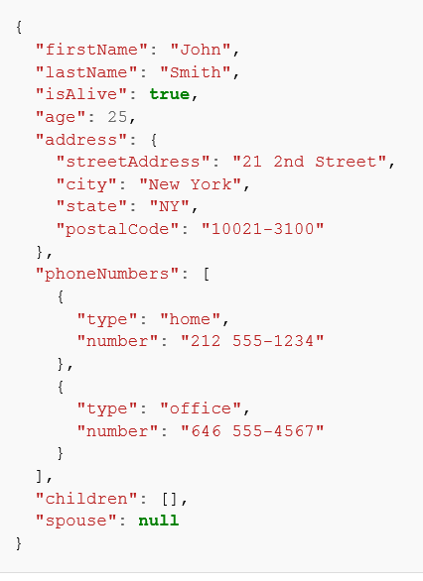
Example JSON
Value is an object
Value is an array

Slide 52
Another example….
{
"id": "0001",
"type": "donut",
"name": "Cake",
"ppu": 0.55,
"batters": {
"batter": [ { "id": "1001", "type": "Regular" },
{ "id": "1002", "type": "Chocolate" },
{ "id": "1003", "type": "Blueberry" },
{ "id": "1004", "type": "Devil's Food" } ]
},
"topping": [
{ "id": "5001", "type": "None" },
{ "id": "5002", "type": "Glazed" },
{ "id": "5005", "type": "Sugar" },
{ "id": "5007", "type": "Powdered Sugar" },
{ "id": "5006", "type": "Chocolate with Sprinkles" },
{ "id": "5003", "type": "Chocolate" }, { "id": "5004", "type": "Maple" }
]
}

Slide 53
Check syntax of JSON
JSON validator
http://jsonlint.com/

Slide 54
JSON Schema
What properties exists
Which type(s) can be used
If properties are required
How the JSON is composed
Why the properties are relevant

Slide 55
The used data type
The allowed properties (for an object)
The allowed items (for an array)
The allowed values (for an enumeration, enum)
If an item is required or optional
The minimum and maximum (for a number)
The pattern to follow (for a string)
…

Slide 56
JSON String
{
"$schema": "http://json-schema.org/draft-03/schema#",
"type": "string"
}

Slide 57
JSON Object
{
"$schema": "http://json-schema.org/draft-03/schema#",
"type": "object",
"properties": {
"foo": {
"type": "string"
},
"bar": {
"type": "number"
}
}
}

Slide 58
Valid Examples
// valid:
{ }
// valid:
{ "foo": "bar" }
// valid:
{ "bar": 3 }
// valid:
{ "baz": false }
// valid:
{ "foo": "bar", "bar": 4.1, "baz": [] }

Slide 59
Invalid Examples
// invalid:
[]
// invalid:
{ "foo": false }
// invalid:
{ "bar": "foo" }
// invalid:
{ "foo": "bar", "bar": [] }

Slide 60
Alternative Value Types
{
"$schema": "http://json-schema.org/draft-03/schema#",
"type": "array",
"items": {
"type": [
{ "type": "string" },
{ "type": "number" }
]
}
}

Slide 61
Similar Constraints
{
"type": "object",
"properties": {
"foo": {
"type": "array",
"items": { "type": [ { "type": "string" }, { "type": "number" } ]}
},
"bar": {
"type": "array",
"items": { "type": [{ "type": "string" },{ "type": "number" } ]}
}
}
}

Slide 62
Code Example
{
"definitions": {
"MyArray": {
"type": "array",
"items": {
"type": [ { "type": "string" },{ "type": "number" }]
}
}
},
"type": "object",
"properties": {
"foo": { "$ref": "#/definitions/MyArray"},
"bar": { "$ref": "#/definitions/MyArray"}
}
}

Slide 63
Required Properties
{
"$schema": "http://json-schema.org/draft-04/schema#",
"type": "object",
"properties": {
"foo": {
"type": "string"
},
"bar": {
"type": "number"
}
},
"required": [
"foo"
]
}

Slide 64
Better way to Indicate Type
{
"$schema": "http://json-schema.org/draft-04/schema#",
"type": "array",
"items": {
"oneOf": [
{ "type": "string" },
{ "type": "number" }
]
}
}
Also can have “anyOf,” or allOf”

Slide 65
Constraining Property Values
{
"$schema": "http://json-schema.org/draft-04/schema#",
"type": "object",
"properties": {
"foo": {
"enum": ["bar", "baz"]
}
},
"patternProperties": {
"^[A-Za-z]+[A-Za-z0-9]*$": {}
},
"additionalProperties": false,
"required": [ "foo" ]
}

Slide 66
Regular Expressions….
A single unicode character (other than the special characters below) matches itself.
Matches any character except line break characters.
^: Matches only at the beginning of the string.
$: Matches only at the end of the string.
(...): Group a series of regular expressions into a single regular expression.
|: Matches either the regular expression preceding or following the | symbol.
[abc]: Matches any of the characters inside the square brackets.
[a-z]: Matches the range of characters.
[^abc]: Matches any character not listed.
[^a-z]: Matches any character outside of the range.
+: Matches one or more repetitions of the preceding regular expression.
*: Matches zero or more repetitions of the preceding regular expression.
?: Matches zero or one repetitions of the preceding regular expression.

Slide 67
Phone Number….
{
"type": "string", "pattern": "^(\\([0-9]{3}\\))?[0-9]{3}-[0-9]{4}$"
}

Slide 68
Alternative Types
{
"$schema": "http://json-schema.org/draft-04/schema#",
"oneOf": [
{ "type": "number" },
{ "enum": [1, 2, 3, "hello"] }
]
}

Slide 69
Numeric Constraints
{
"$schema": "http://json-schema.org/draft-04/schema#",
"description": "Validates the numeric value of the CSS font-weight property.",
"type": "integer",
"minimum": 100,
"maximum": 900,
"multipleOf": 100
}

Slide 70
Code Example
{
"$schema": "http://json-schema.org/draft-04/schema#",
"type": "string",
"minLength": 1,
"maxLength": 3
}

Slide 71
Code Example
{
"$schema": "http://json-schema.org/draft-04/schema#",
"type": "string",
"pattern": "^[A-Za-z]{1,3}$"
}

Slide 72
Array Type Constraints
{
"$schema": "http://json-schema.org/draft-04/schema#",
"type": "array",
"items": {
"type": "number"
}
}

Slide 73
Alternative Types in Array
{
"$schema": "http://json-schema.org/draft-04/schema#",
"type": "array",
"items": {
"oneOf": [
{ "type": "number" },
{ "type": "string" }
]
}
}

Slide 74
Helpful sites
www.regex101.com
https://www.jsonschemavalidator.net

